Slide 1

Bitcoin; time series analysis of historical price
Final Project MATH 1318
Napapach Dechawatthanaphokin; s3613572
Rahul Kumar Gupta; s3635232
Terrie Christensen; s3664899

Slide 2
Introduction
This presentation is part of the final project for MATH 1318; Time Series Analysis. The competitive project was selected by our team, in which a data series for the historical price of Bitcoin was given.
Bitcoin is a type of cryptocurrency, i.e. it is a digital currency which uses encryption techniques to generate units of the currency and verify the transfer of funds. Bitcoin is a decentralised currency, which operates independently of a central bank. An estimated 2.9 to 5.8 million unique users have a ‘cryptocurrency wallet’, of which most use bitcoin [1]. The price of bitcoin has gone through various cycles of appreciation and depreciation, known as bubbles and bursts, with price fluctuations up to a magnitude of a few thousand USD in the space of a day [2], so that the currency has become renown for its volatility. The bitcoin historical price data gathered from the ’CoinMarketCap’[3].
This time series will be modelled using regression, ARIMA and GARCH methods. This presentation details;
Description of the time series
Model specification
Model fitting and selection
Diagnostic checking
Predict the value of bitcoin for the following 10 days
Image on title page; https://themerkle.com/bitcoin-may-still-see-a-blockchain-split-on-august-1st/

Slide 3
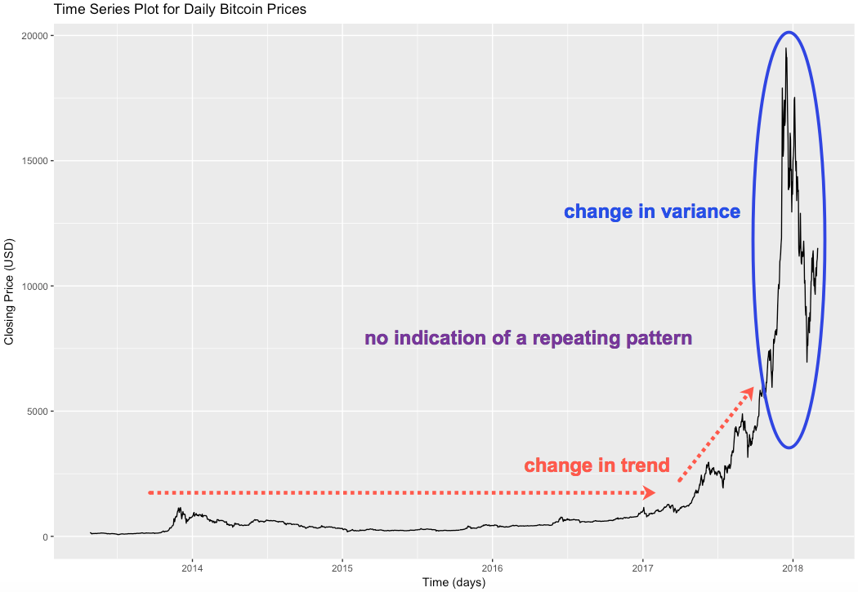
Bitcoin historical price; the time series
The plot shows the daily closing price of bitcoin from the 27/04/2013 to the 03/03/2018, given in USD.
Main characteristics of the time series;
Change in trend, at ~ 2017
Change in variance, large spikes in price at the end of the time series
Auto regressive behavior
A flat trend is observed from the start of the time series to early 2017.

Slide 4
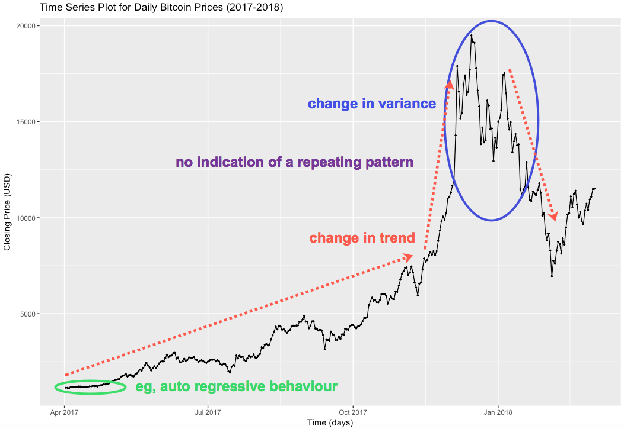
Bitcoin historical price; the edited time series
The ‘flat’ part of the time series is removed, to better model the later part of the time series which shows a change in bitcoin price.
The plot shows the daily closing price of bitcoin from the 01/04/2017 to the 03/03/2018, given in USD.
Main characteristics of the time series;
Change in trend
Change in variance, large spikes in price at the end of the time series
Auto regressive behavior

Slide 5
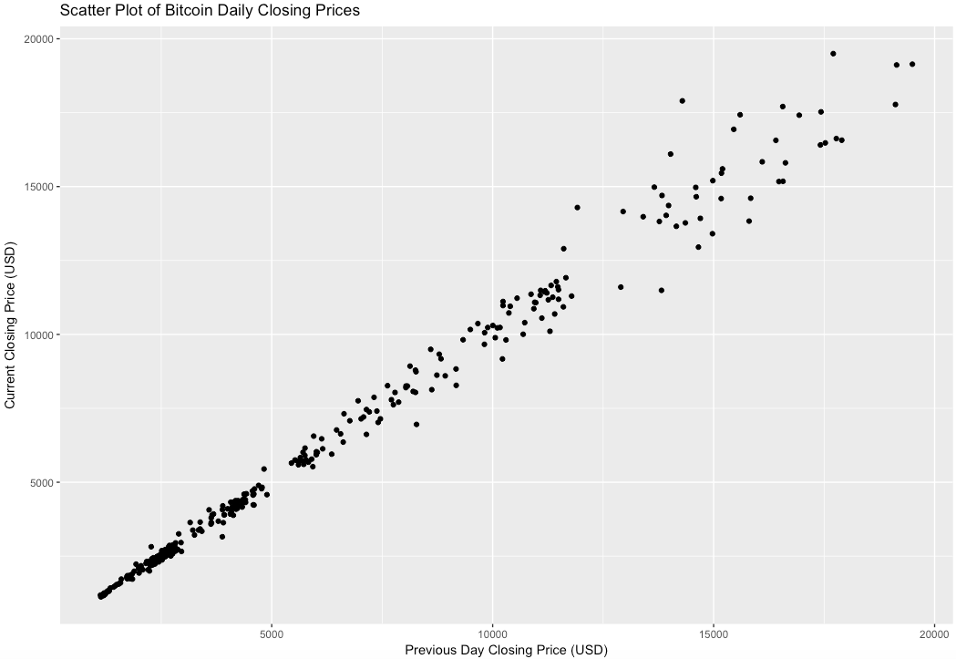
Correlation between consecutive points for the Bitcoin time series
The scatter plot shows the relationship between consecutive points, to determine the presence of auto regressive behaviour.
A correlation index of 0.9935 was calculated.
This is indicative of a strong positive correlation between neighboring Bitcoin values, and in turn the presence of auto correlation.

Slide 6
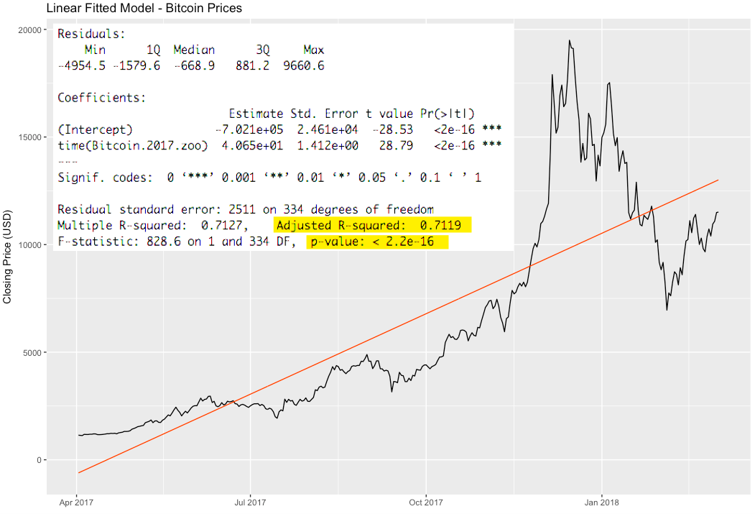
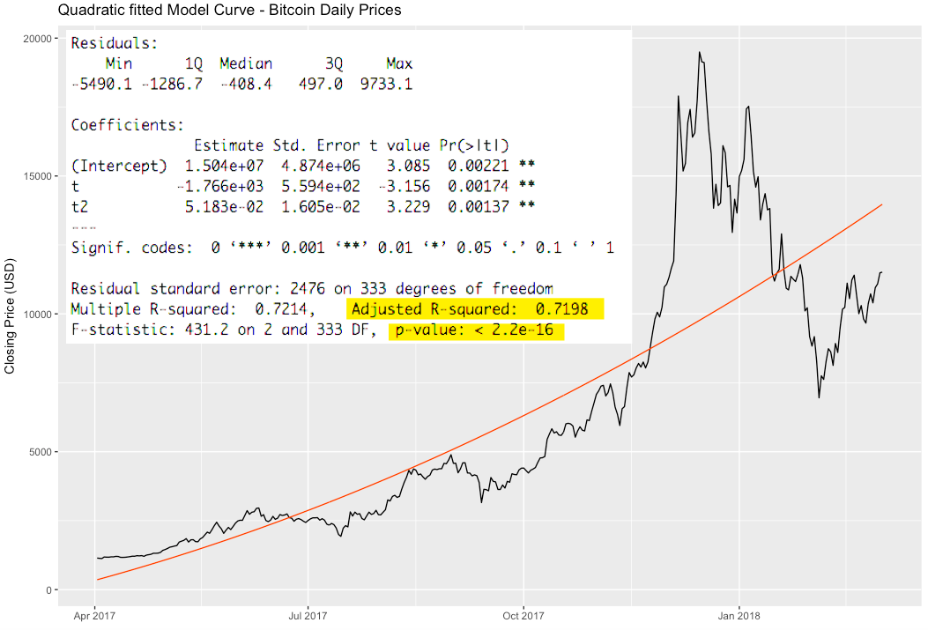
Regression models for the bitcoin time series
The plots give the regression models for the linear and quadratic trend lines.
Both models are statistically significant, with the same p-value of 2.2e-16.
They both also have a similar adjusted R-squared values; 0.7119 and 0.7198 for the linear and quadratic models respectively, i.e. ~ 71% of the variation in the time series can be explained by these models.
With similar results, the more conservative linear model is preferred.

Slide 7
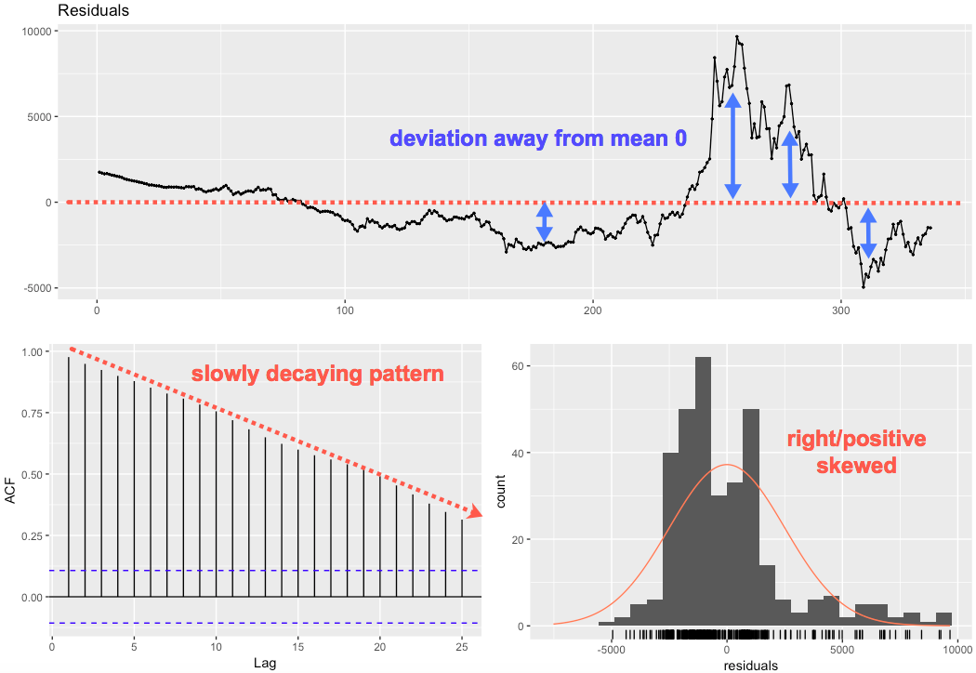
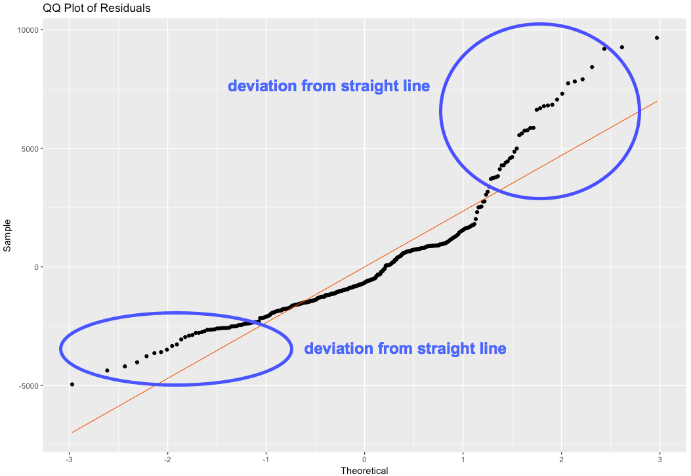
Diagnostic checks for the linear model
The panel above left gives a (time series) plot, ACF, and histogram of the standardized residuals for the linear model of the Bitcoin time series. The plot to the right shows the normal QQ plot of residuals.
The standardized residuals show large deviations from the mean 0 in the (time series) plot, and an asymmetric distribution in the histogram, both suggesting large errors. The QQ-plot also shows points diverging away from the straight line at either tail, indicating the residuals are not normally distributed. The ACF shows a slow decaying pattern with many significant lags, suggestive of auto correlation.
The Shapiro-Wilk test of normality (not shown) returned a p-value of 1.204e-15, so the NULL hypothesis is rejected, again suggesting that the residuals are not derived from a normally distributed population.
The linear model does not pass the diagnostic checks, thus the linear model does not capture all the information in the time series and is not suitable for forecasting.

Slide 8
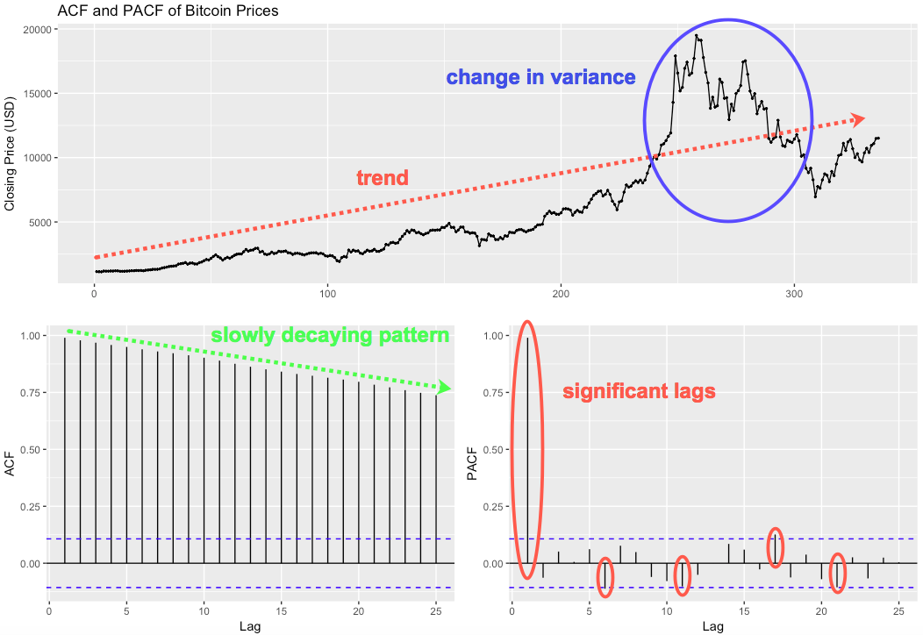
ACF and PACF plots of the non-stationary time series
The uppermost plot in the panel shows points in the time series, with a trend and change in variance.
The ACF plot shows a slowly decaying pattern with many significant lags. There is no indication of a wave/sine pattern, so that a seasonal component is not determined.
PACF plot show a large 1st significant lag, with 4 smaller significant/near significant lags.
The time series needs to be stabilized and de-trended prior to specifying a set of possible ARIMA models.

Slide 9
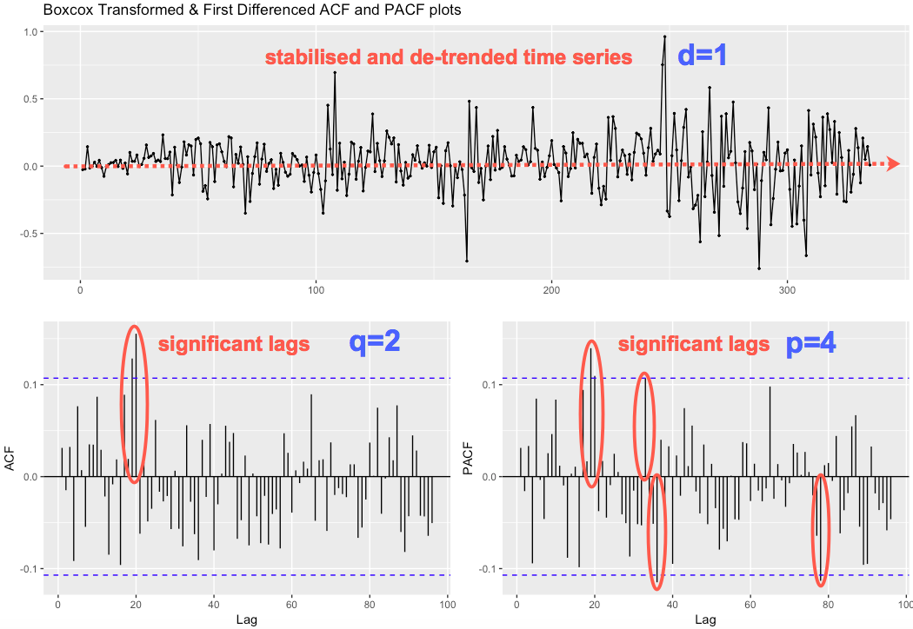
ACF and PACF plots of the stationary time series
Calculation of the log-likelihood for each lambda value, using the yule-walker method gave a lambda value 0.1-0.2.
A BoxCox transformation was applied to stabilize the time series.
1 differencing was applied to de-trend the time series, i.e. d=1.
The uppermost plot in the panel shows the result of transformation and differencing.
Dickey-Fuller Unit-Root test gave a p-value of 0.01, thus the NULL hypothesis is rejected, and in turn the time series is determined to be stationary.
The ACF plot shows 2 significant lags, i.e. q=2.
PACF plot shows 5 significant lags, however the 5th is ~lag 80, so not included, i.e. p=4, but the adjacent value p=3 may also be considered.
{ARIMA(4,1,2), ARMIA(3,1,2)} are included in the set of possible models.

Slide 10
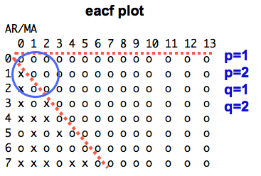
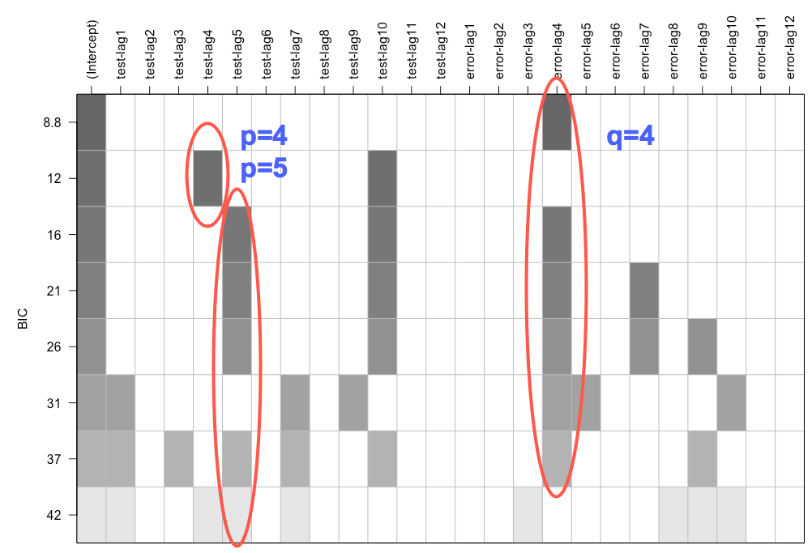
eacf and BIC for further model specification
The eacf plot shown above left, identified possible smaller ARIMA models with a p=1, 2 and q=1, 2.
The BIC plot given above right, identified possible larger ARIMA models with a p=4, 5 and q=4. A p=10 was disregarded with smaller values identified.
Thus {ARIMA(1,1,1), ARMIA(1,1,2), ARIMA(2,1,1), ARIMA(2,1,2), ARIMA(4,1,4), ARIMA(5,1,4)} are added to the set of possible models.

Slide 11
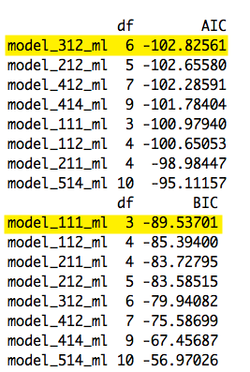
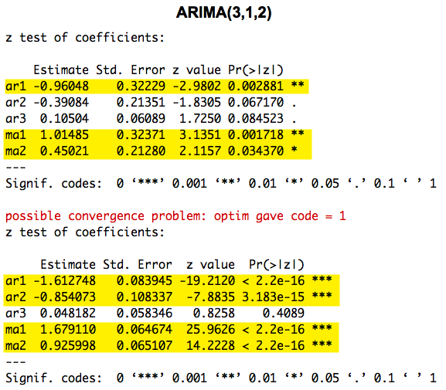
Estimation of ARIMA model parameters
The set of possible models; {ARIMA(1,1,1), ARMIA(1,1,2), ARIMA(2,1,1), ARIMA(2,1,2), ARMIA(3,1,2), ARIMA(4,1,2), ARIMA(4,1,4), ARIMA(5,1,4)}.
The ARIMA(5,1,4) was the only model to show all significant parameter coefficients with the CSS method (but none with the MLE method).
The table far left shows the sorted AIC and BIC scores. However, the AIC and BIC functions identify different models as the best, with ARIMA(3,1,2) and ARIMA (1,1,1) given respectively.
The table above right shows the calculated parameter coefficients for the ARIMA(3,1,2) model, the CSS method showed the AR(1), MA(1) and MA(2) components to be significant, while the MLE method AR(1), AR(2), MA(1) and MA(2) components to be significant.
The calculation for parameter coefficients for the ARIMA(1,1,1) model returned NA values.

Slide 12
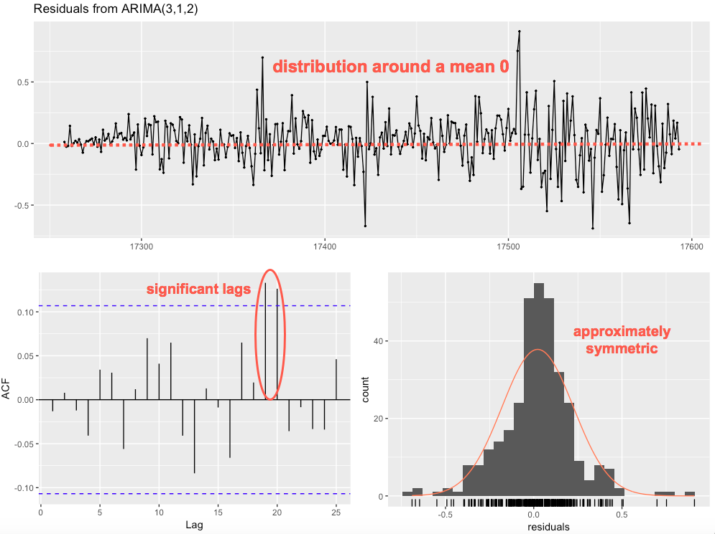
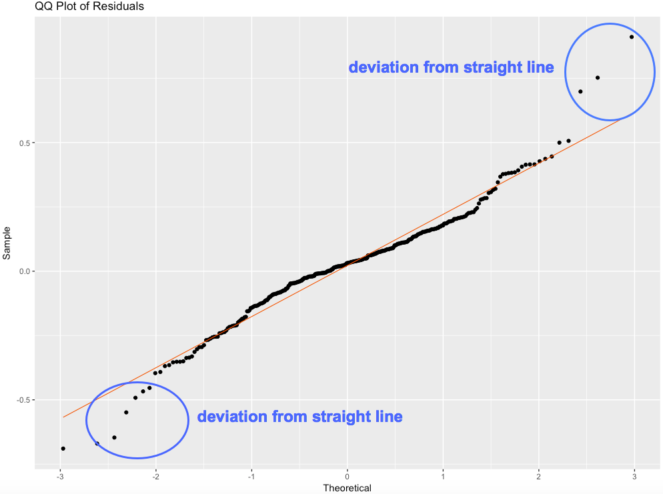
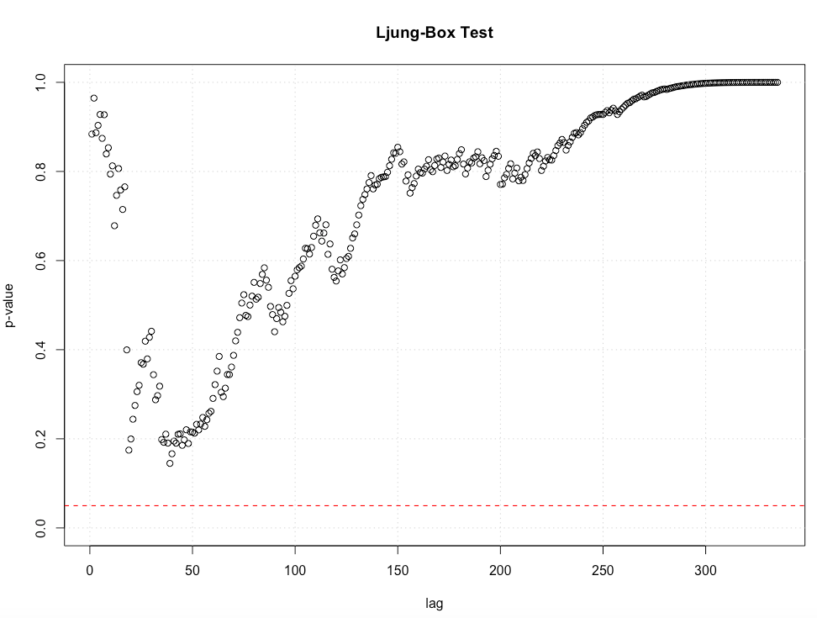
Residual analysis of the ARIMA(3,1,2) model
The QQ plot of residuals given to the immediate left shows the points plotting along the straight line with only a few points deviating at either tail.
The Ljung-box test shows all the residuals above a p-value of 0.5.
Residual analysis of the ARIMA(3,1,2) indicate the model has captured information in the time series.
The plot of residuals shown uppermost in the panel above shows the residuals scattering around the mean 0 without a pattern.
The histogram shows an approximately symmetric distribution around 0.
The ACF does not show a pattern, although there are 2 significant lags which may indicate some auto correlation in the residuals.

Slide 13
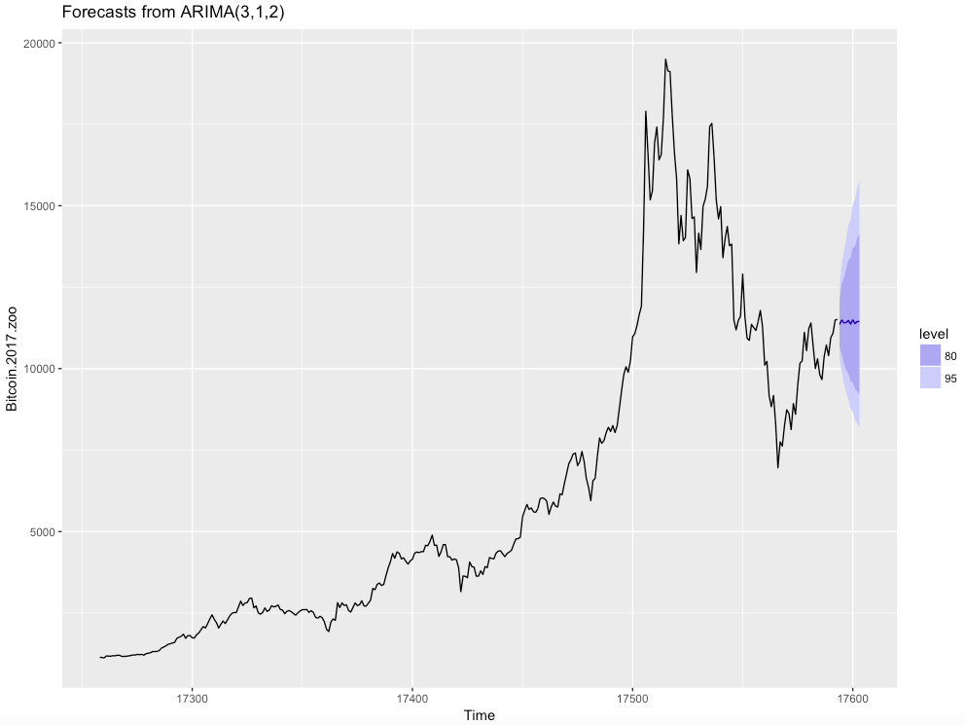
Prediction of bitcoin price using ARIMA(3,1,2)
The plot show the original time series for the historical price of bitcoin.
A prediction of the following 10 days is given with the ARIMA(3,1,2) model.
The forecast shows a steady bitcoin price, with a possible increase or decrease within the range of the confidence interval (80 and 95%) bounds.

Slide 14
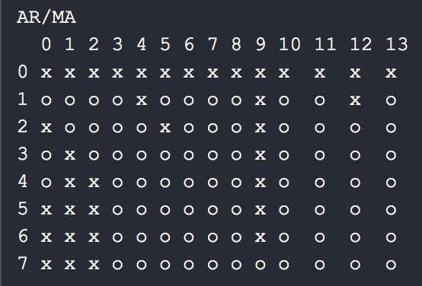
Models of Heteroscedasticity
McLeod-Li test is significant at 5% level of significance for all lags. This suggest existence of volatility clustering
From absolute value transformation, we observe many significant lags in both ACF and PACF
EACF do not suggest an ARMA(0,0)
EACF, we can identify ARMA(1,0), ARMA(1,1), and ARMA(2,1) models for absolute value series.
Proposed GARCH models are GARCH(0,1), GARCH(1,1), GARCH(1,2).

Slide 15
Conclusions
Regression models are not suitable for daily bitcoin closing prices.
ARIMA model is good, but the mean absolute scaled error of 3.2, (three times higher than original) is not practical for prediction.
ARIMA models are not suitable as they are unable to capture high volatility in series.
Combination of ARIMA (mean) and GARCH (variance) prediction model can be better for daily bitcoin closing prices.

Slide 16
References
[1] https://en.wikipedia.org/wiki/Bitcoin
[2] Jay Adkisson. Why Bitcoin is So Volatile. (09/02/2018). https://www.forbes.com/sites/jayadkisson/2018/02/09/why-bitcoin-is-so-volatile/#2d9cc9c639
[3] https://coinmarketcap.com/

